Slide 1
Course Selection for 2024-25
SFACSS
February 27- March 1, 2023

Slide 2
Land Acknowledgement
We are currently gathered on the traditional territories of the Ta'an Kwäch'än Council and the Kwanlin Dün First Nation. Acknowledging that we are fortunate to live, learn, work, and play on this land is an important step towards reconciliation.

Slide 3
2018 Graduation Program Requirements
Minimum of 80 credits of grade 10-12 courses.
Most courses are 4 credits: 4 courses per semester for 3 years would amount to 96 credits.
52 of the 80 credits are mandatory, and 28 credits are electives.
At SFACSS, we also require:
Religion 10 (Christ and Culture 10) (2 credits)
World Religions 12 (4 credits): This is the grade 11 Religion requirement
An additional Religion 12 (4 credits): Choices are between Philosophy 12, Morals and Ethics 12, Social Justice 12, and Yukon First Nations Studies 12

Slide 4
Change from grade 9: Linear to Semester
Semester 1
1-2 (course)
3-4 (course)
5-6 (course)
7-8 (course)
Semester 2
1-2 (course)
3-4 (course)
5-6 (course)
7-8 (course)

Slide 5
Pathway to Graduation
80 credits (or 20 courses)
Grade 10 | Grade 11 | Grade 12
English 10 Math 10 Science 10 Social Studies 10 Career Life Education/ Christ & Culture 10* Physical Education 10 Elective (or Language) Elective | English 11 Math 11 A Science 11 A Social Studies 11 or 12 World Religions 12* Elective Elective Elective | English 12 Career Life Connections 1 Religion 12* (4 options) Elective 12 Elective 12 Elective Elective Elective (or Grad Spare)
*SFACSS Religious education requirement

Slide 6
English
Grade 10
- Composition 10 (2 credits)
and New Media 10 or Literary Studies 10 (2 credits)
Grade 11
English First Peoples Literary Studies & New Media 11
English First Peoples Literary Studies & Writing 11
Grade 12
English Studies 12

Slide 7
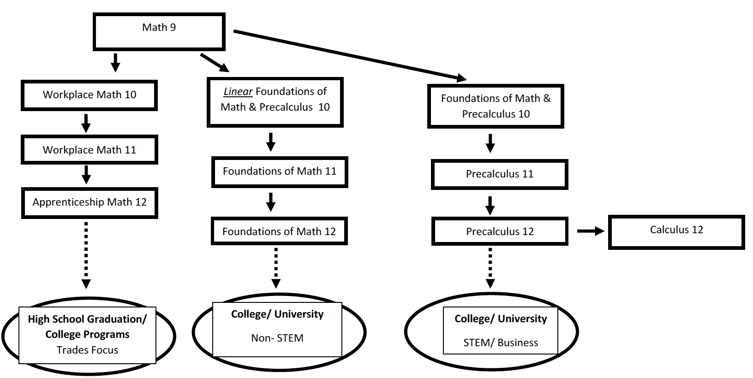
Math

Slide 8
Science
Grade 10
-Science 10
Students are required to complete 4 credits of Science 11 or 12 to graduate:
- Chemistry 11 | - Chemistry 12
- Earth Science 11 | - Geology 12
- Life Sciences 11 | - Anatomy & Physiology 12
- Physics 11 Physics 11/Outdoor Ed. Program (new) | - Physics 12

Slide 9
Needing extra support?
Linear Composition and New Media 10 (4 credits)
Linear Foundations of Math and Precalculus 10 (4 credits)
Skills block 10-12 (with administration & parent permission) (No credit)
Academic Language for English Language Learners 10-12 (4 credits)
Learning Strategies 10-12 (4 credits)

Slide 10
Social Studies
Grade 10
-Social Studies 10
- Sciences Humaines 10
Students are required to complete 4 credits of Social Studies 11 or 12 to graduate:
- 20th Century World History 12 | - Law 12
- Asian (Philippines) Studies 12 | - Political Studies 12
- Genocide Studies 12

Slide 11
Career and Religious Education
Grade 10
Career Life Education/ Christ & Culture 10 (6 credits)
Grade 11
Comparative World Religions 12
Grade 12
- Career Life Connections
- Choose at least 1 religion course:
- Morals & Ethics 12 | - Social Justice 12
- Philosophy 12 | - Yukon First Nations Studies 12

Slide 12
Service-Learning Hours
Grade 10
15 hours
Grade 11
15 hours
Grade 12
Students need a total of 30 hours between grades 10, 11, and 12. Therefore, if they have met the requirements in grade 10 and 11, they did not need to log hours in grade 12

Slide 13
Physical Education
Grade 10
Physical Education 10
Physical Education 10 Wellness

Slide 14
Languages
Grade 10
French 10
Sciences Humaines 10
Grade 11
Introductory French 11
Introductory Spanish 11
French 11
Spanish 11
Grade 12
French 12
*There is no Language requirement for graduation. Some universities require a Language 11.

Slide 15
Grade 10
English 10
Math 10
Science 10
Social Studies 10
Career Life Education/ Christ & Culture 10*
Physical Education 10
Elective (or French 10 or Intro Language 11)
Elective

Slide 16
Grade 11
English 11
Math 11
A Science 11
A Social Studies 11 or 12
World Religions 12*
Elective
Elective
Elective

Slide 17
Grade 12
English 12
Career Life Connections
1 Religion 12* (4 options)
Elective 12
Elective 12
Elective
Elective
Elective (or Grad Spare)

Slide 18
Arts
* One Art or ADST course is required for graduation
Visual Arts: Art Studio Visual Arts: Photography | Drama Musical Theatre Music: Beginner Rock Band Music: Choir Music: Jazz Band Music: Rock Band
* Drama, musical theatre, and music classes may be offered after school for credit

Slide 19
Applied Design, Skills, and Technology (ADST)
* One Art or ADST course is required for graduation
Computer Information Systems Entrepreneurship Food Studies Interpersonal & Family Relationships 11 Media Design | Metalwork Technology Explorations Textiles Theatre Production Woodwork

Slide 20
Other Electives
Active Living 11/12 Fitness & Conditioning 11/12 Psychology 12 Work Experience 12
Application (talk to school counsellor): Teacher Assistant Dual Credit at Yukon University Independent Directed Studies

Slide 21
External Credits
Yukon Driver’s Academy (2 credits)
Bronze Cross/ National Lifeguard/ Swim Instructor (2 credits each)
Athlete 10, 11 & 12 (Arctic Winter Games, Canada Summer Games, Canada Winter Games (4 credits each)
Royal Conservatory 10, 11 & 12 (4 credits each)
••• and many more
https://www2.gov.bc.ca/gov/content/education-training/k-12/support/graduation/getting-credit-to-graduate/external-credentials

Slide 22
Things to Consider
Of the 80 credits required for graduation, students must earn at least 16 credits (4 courses) at the grade 12 level.
KEEP YOUR OPTIONS OPEN:
Take a minimum of four to six academic grade 12 courses
Check pre-requisite courses needed for your future desired program

Slide 23
University Admission Requirements
Science/Engineering | Arts/ Humanities
English 12 Math 12 – Pre-calculus Science 12 Science 12 Additional course for Alberta and Ontario *Science – may require Physics 11 * Chemistry 12 & Physics 12 for Engineering, recommend Calculus 12 | English 12 3 to 5 Grade 12 Academics *Language 11 (Some universities) * Math 11 or 12(Foundations or Pre-calculus – check with university)

Slide 24
Programs at Other Schools?
Applications for Wood Street Centre (MAD, FACES, ACES, CHAOS, Experiential Science) and Sport School (at FH) are no longer being accepted for this year.
FADS (Porter Creek) is accepting students for the waitlist.
WILD ( at Porter Creek, runs every second year), next year is 2024-25.
If a student has been accepted to a program outside of SFACSS, they need to communicate with the school counsellors to ensure they are scheduled in the appropriate courses.

Slide 25
Questions?
Contact a school counsellors:
Colleen Segriff: colleen.segriff@yesnet.yk.ca
Jen Moran: jennifer.moran@yesnet.yk.ca

