Slide 1
Welcome to Saint Francis of Assisi Catholic Secondary
Grade 7 going into 8 Parent Meeting 2024

Slide 2
Land Acknowledgement
We are currently gathered on the traditional territories of the Ta'an Kwäch'än Council and the Kwanlin Dün First Nation. Acknowledging that we are fortunate to live, learn, work, and play on this land is an important step towards reconciliation.

Slide 3
To educate children in a Catholic learning environment. Through the sharing of knowledge and Christian values and by celebrating our Catholic faith, students are assisted in developing a personal faith and an understanding and appreciation of self and others. Each child has the opportunity to strive for academic excellence and to reach his or her potential as a life-long learner. The uniqueness of each child is celebrated.
Saint Francis Mission Statement

Slide 4
Transition to Grade 8 is a Big Deal
Different expectations
New friends and navigating new social situations
Mixing with other students from other schools
New and more teachers
Finding their way around a bigger building
New options and opportunities
More independence
No longer the top dogs-go from being the oldest in school to the youngest
Fears and excitement
A team to help them through

Slide 5
What does Saint Francis of Assisi Catholic Secondary Offer Students?
We are different and we are proud of that difference
A big school experience in a smaller school setting
A common set of values
Education of the whole child-academic, physical, emotional and spiritual
The opportunity to discuss and learn important moral and ethical teachings because we are a Catholic school
A family atmosphere where teachers, administrators and staff know the students well and follow them through the years
A teaching and administration staff that believes in the power of personal contact and good communication with families
A partnership of student-family-school through 5 years of a significant developmental life stage
Close involvement of staff in all programs – from sports to graduation

Slide 6
Clubs: meet at lunch
Student government
Board Games/Chess Club
Social Justice
GSA Club
Beading and crafts
Work-out club
Debate Club
Ping-Pong Club
Robotics Club
Skills Canada Club
Students can request a club and we will start one!
Sports: after school – “no cut” policy for grade 8s
Volleyball
Basketball
Badminton
Track and Field
Soccer
Mountain Biking
Long Boarding
Running

Slide 7
We have an extensive Music program
The Saint Francis music department has been busy this year. Students have been learning foundational music and instrument skills through performing their favorite rock music hits.
While learning the fundamentals of their instrument, they are also playing with a band in a fun and positive atmosphere.
We have: music courses as electives and after school music credit courses.

Slide 8
Expectations of Grade 8s
Good attendance
Participation in all aspects of the academic and religious education program
Learning self-advocacy skills such as asking for help
Pro-social behavior and respect for all staff and other students
Excellent sportsmanship on and off the court/field
Good health and hygiene habits- eating, sleeping, body and hand hygiene
Developing of self-regulation skills
Following rules of the school-phone use, hat rule, dressing appropriately, attending classes, keeping up with school-work

Slide 9
What does Grade 8 Look Like?
Rotating Timetable
Most courses are year long
In regular years grade 8s have lockers
8 classes mean lots of work to keep up with and organize
Lunchtime is open and non-restrictive
Cafeteria, Bring a lunch, Walk home, Go off campus
Course choices are limited
Elective and activity choices are more personal
Exams
Attendance: Students need to take more independent responsibility for missed time to stay caught up

Slide 10
What Courses do Grade 8’s Take?
Elective Courses-1/2 Year Students take 2
English and Social Studies (Humanities)
Science and Math (Scimatics)
Religion
Physical Education
French
some students will not take French by teacher recommendation and/or parent consultation
Skills or ELL are two alternatives
Drama
Industrial Arts
Home Economics
Music
Fine Art
Information Technology

Slide 11
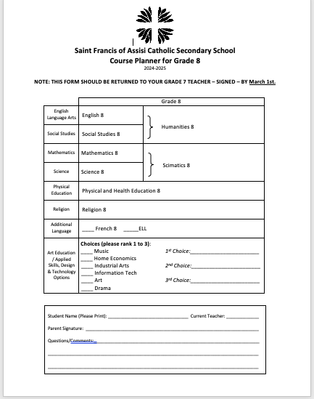

Slide 12
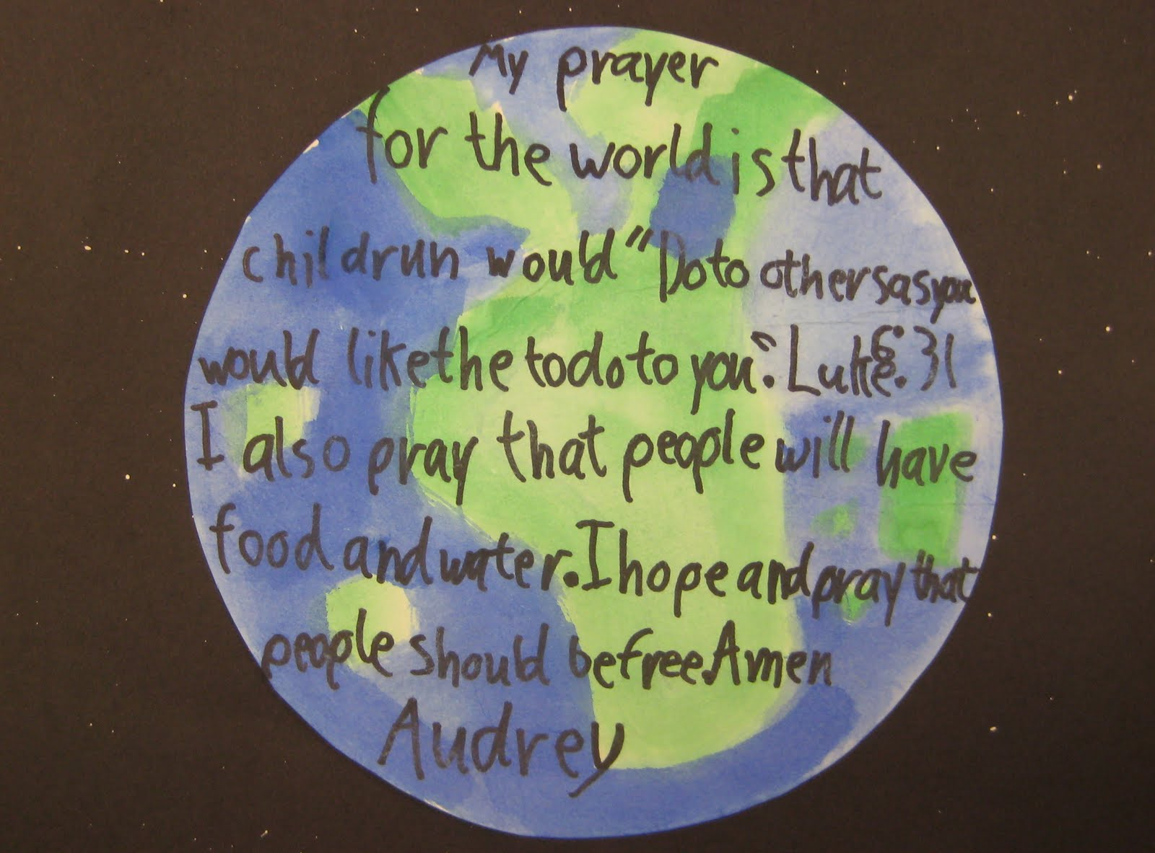
Daily Prayer
Every day at 8:40am
Teachers prepare from a variety of sources
Focus on building community and expressing gratitude ☺

Slide 13
Service Learning
As part of their religion courses, students are required to complete volunteer/service hours as well as a small reflection assignment in order to receive their religion credits. These hours must be completed outside of class time and students must not receive compensation in any form for their time and effort. These hours are voluntary. We encourage students to seek out these opportunities and can assist if needed.
Grade 8: 5 hours
Grade 9: 10 hours
Grade 10: 15 hours
Grade 11: 15 hours
Grade 12: All Yukon students need a total of 30 service hours between grades 10, 11 and 12. Therefore, if you meet the requirements in grade 10 and 11, you will not need to formally log hours in grade 12.

Slide 14
Supports for Grade 8 Students
Teachers
Educational Assistants
Learning Assistance Teacher
Counsellors
Administration
Tutors
Yukon First Nations Education Advocate

Slide 15
Counselling Department: Ms. Segriff Ms. Moran

Slide 16
Students can make their own decisions about seeing a counsellor in high school.
Counsellors will be in contact if there are issues of safety or serious concern.
Many issues that students come to counsellors for are academic concerns (feeling overwhelmed) and friendship concerns.
Counsellors also help students sort out their career plans, apply for scholarships and post-secondary training, get help with apprenticeships, and many other career related concerns.
Counsellors work in classrooms, with small groups, and do a lot of conflict resolution.
Counsellors also can refer students and families to outside supports including Mental Wellness and private counsellors.

Slide 17
Learning Assistance with Mrs. Cann

Slide 18
What does a learning assistance teacher do?

Slide 19
Help students with Individual Education Plans
Help students with Student Support Plans
Organize the Tutoring program
Run the Skills room
Organize Educational Assistants in the school
Run lunch time study sessions in the skills room
Help students learn to take notes, create study sheets, and use study strategies
Administer level one assessments to determine skill levels in numeracy and language arts
Consult with parents, school psychologist, counsellors and administration to get the right supports for students
Help prepare for exams and deliver test-taking support

Slide 20
And Finally….

Slide 21
How Can Parents Help?
Make sure they get to school every day and call us when they must be absent
Keep in contact with your child’s teachers
Make sure your child gets enough sleep and good nutrition
Set rules and guidelines around attendance, technology and school
Know what your child is doing on social media-it is ok to check!
Get to know who your child is socializing with
Check in with your child every day
Set curfews and bedtime expectations
Have family time expectations
Keep in mind that there are always different sides to the story
Each child will experience the challenges of adolescence uniquely
Remember we are all on the same team

Slide 22
What you can expect as next steps:
We are visiting Holy Family and Christ the King grade 7 classrooms in the next week to give your child the same presentation. Holy Family is on February 20th and CKES is on February 21st.
We will be giving them a course selection sheet to bring home and sign. They must bring it back to their teacher. They will be asked to indicate their preference of electives, numbered as 1st, second, and 3rd choice. Their teacher will number their sheet when they come back to the teacher.
We then pick up the forms after the deadline (March 1st) so we can input courses once our master timetable is created.
Grade 7 orientation: End of May, beginning of June

